Slide 1
Grammars

Slide 2

Grammars
Grammars express/specify languages
Example: Grammar of English language
Courtesy Costas Busch - RPI

Slide 3
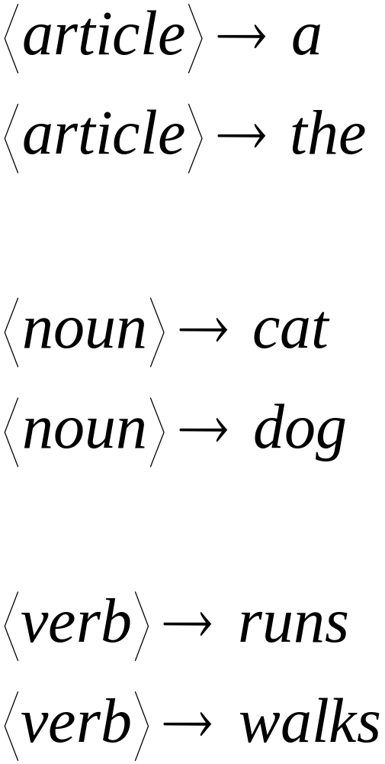
Courtesy Costas Busch - RPI

Slide 4
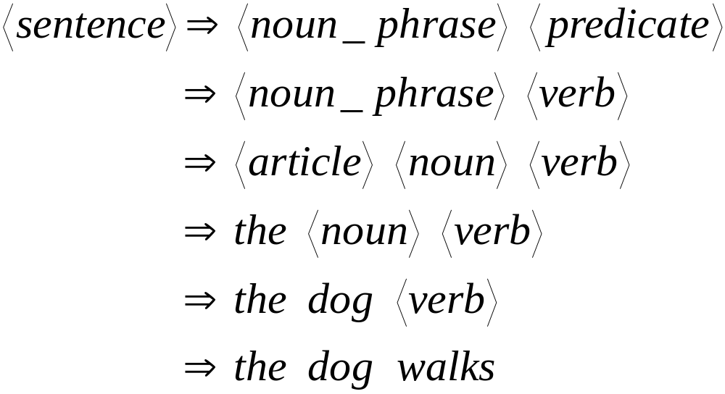
A derivation of string “the dog walks”:
Courtesy Costas Busch - RPI

Slide 5
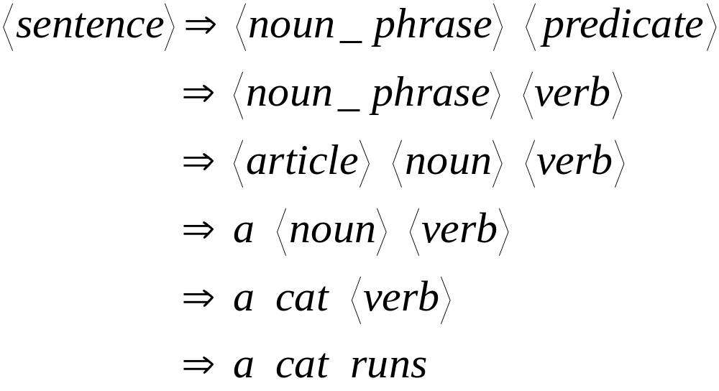
A derivation of string “a cat runs”:
Courtesy Costas Busch - RPI

Slide 6

Activity
Time
Derive string: "Colorless green ideas sleep furiously"
An Interesting Read: http://www.mit.edu/people/dpolicar/writing/proseDP/text/colorlessIdeas.html

Slide 7
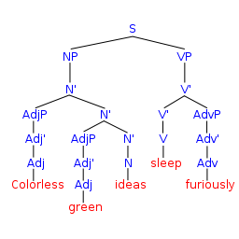
Courtesy wikipedia

Slide 8
Subset of Language produced by the English grammar:
L = { “a cat runs”,
“a cat walks”,
“the cat runs”,
“the cat walks”,
“a dog runs”,
“a dog walks”,
“the dog runs”,
“the dog walks” }
Courtesy Costas Busch - RPI

Slide 9
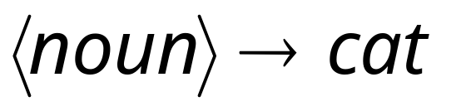
Notation
Productions
Sequence of
Terminals / Alphabets
Variables
Sequence of Variables
Courtesy Costas Busch - RPI

Slide 10
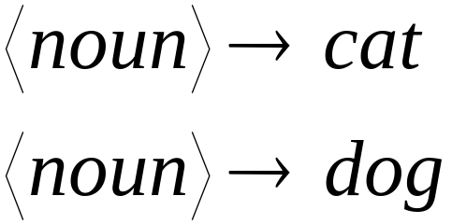
Notation
Production Rules
Variable
Sequence of
Terminals
Courtesy Costas Busch - RPI

Slide 11


Another Example
Sequence of
terminals and variables
Grammar:
Variable
The right side
may be
Courtesy Costas Busch - RPI

Slide 12



Grammar:
Derivation of sentence :
Courtesy Costas Busch - RPI

Slide 13

Other derivations:
Courtesy Costas Busch - RPI

Slide 14
Grammar:
Other derivations:
Courtesy Costas Busch - RPI

Slide 15

Language of the grammar
Courtesy Costas Busch - RPI

Slide 16





More Notation
Grammar
Set of variables
Set of terminal symbols
Start variable
Set of Production rules
Courtesy Costas Busch - RPI

Slide 17




Example
Grammar :
Courtesy Costas Busch - RPI

Slide 18
More Notation
Sentential Form:
A sentence that contains
variables and terminals
Example:
Sentential Forms
sentence
Courtesy Costas Busch - RPI

Slide 19

We write:
Instead of:
for zero or more derivation steps
Courtesy Costas Busch - RPI

Slide 20

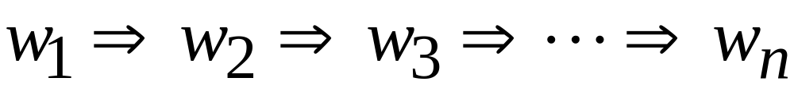
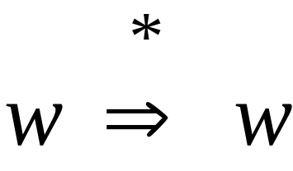
In general we write:
If:
in zero or more derivation steps
Trivially:
Courtesy Costas Busch - RPI

Slide 21
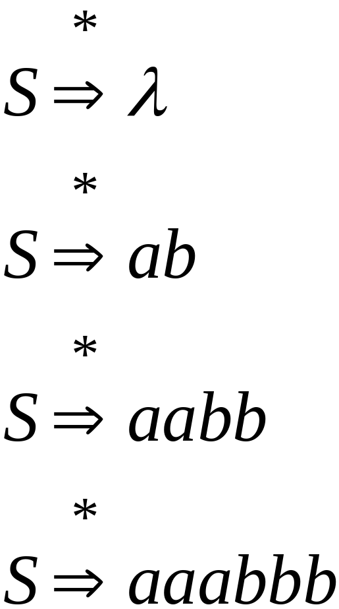
Example
Grammar
Derivations
Courtesy Costas Busch - RPI

Slide 22
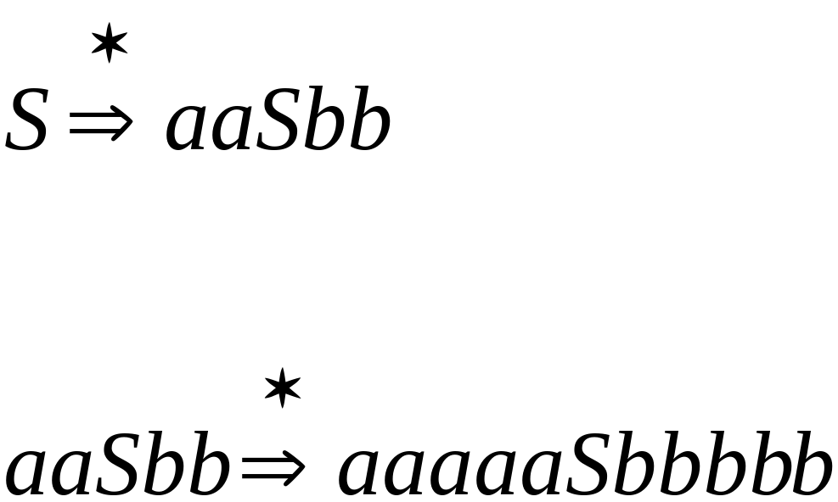
Example
Grammar
Derivations
Courtesy Costas Busch - RPI

Slide 23
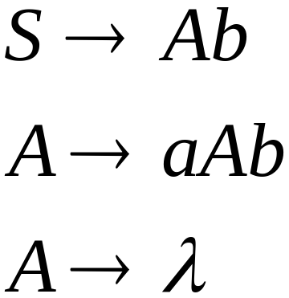
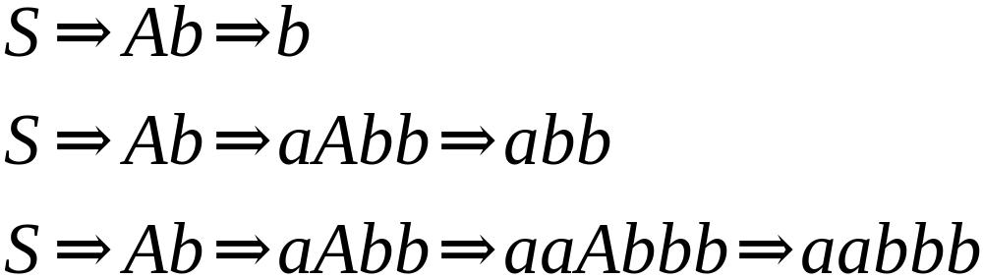
Another Grammar Example
Grammar :
Derivations:
Courtesy Costas Busch - RPI

Slide 24
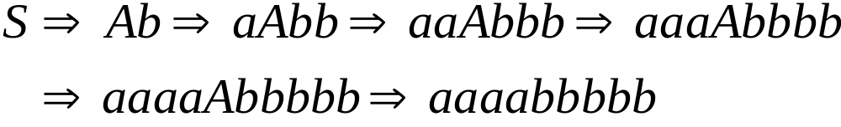
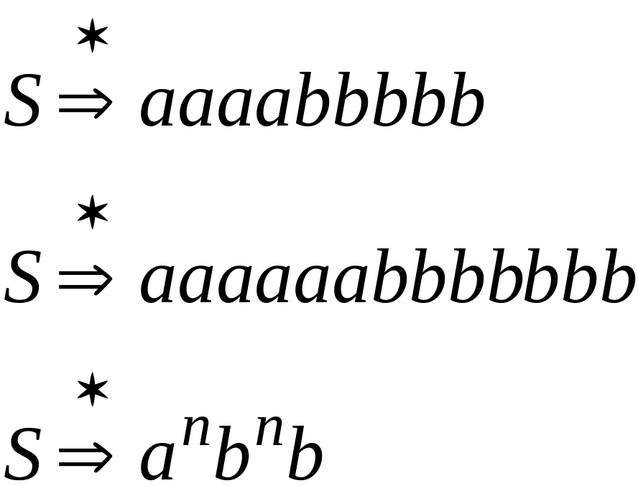
More Derivations
Courtesy Costas Busch - RPI

Slide 25



Language of a Grammar
For a grammar
with start variable :
String of terminals or
Courtesy Costas Busch - RPI

Slide 26

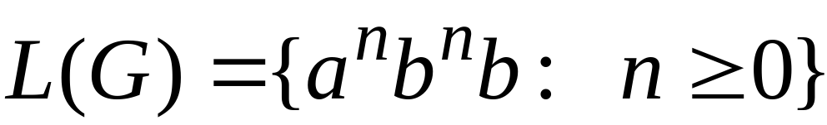
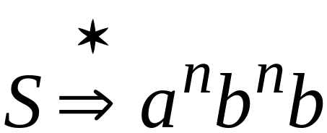
Example
For grammar :
Since:
Courtesy Costas Busch - RPI

Slide 27
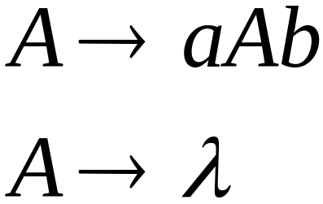
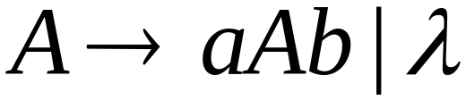
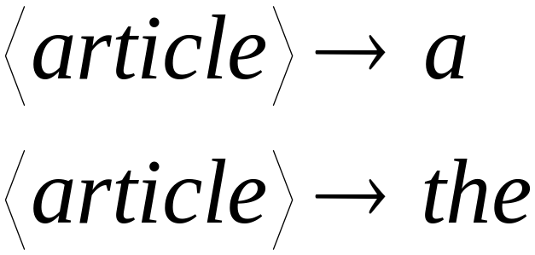
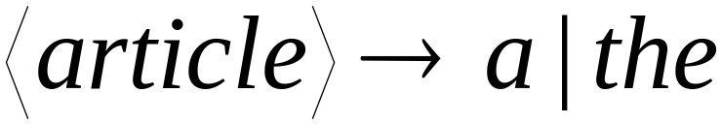
A Convenient Notation
Courtesy Costas Busch - RPI

Slide 28
Linear Grammars

Slide 29
Linear Grammars
Grammars with
at most one variable at the right side
of a production
Examples:
Courtesy Costas Busch - RPI

Slide 30
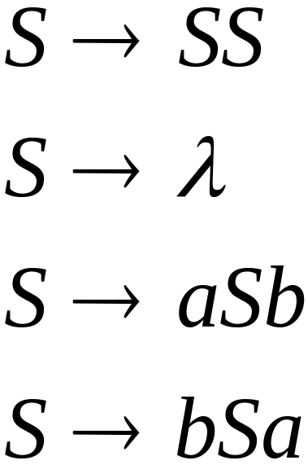
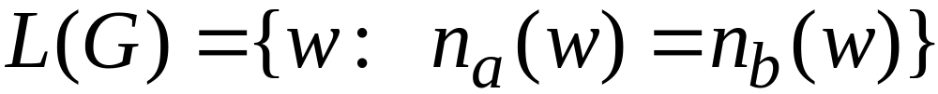


A Non-Linear Grammar
Grammar :
Number of in string
Courtesy Costas Busch - RPI

Slide 31
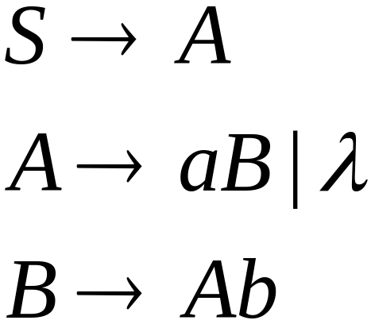
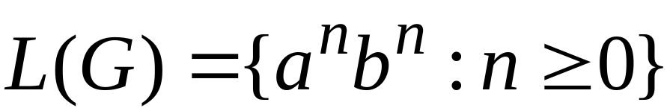
Another Linear Grammar
Grammar :
Courtesy Costas Busch - RPI

Slide 32


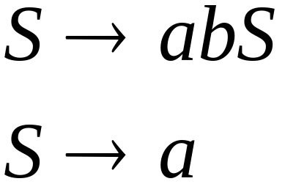
Right-Linear Grammars
All productions have form:
Example:
or
string of
terminals
Courtesy Costas Busch - RPI

Slide 33

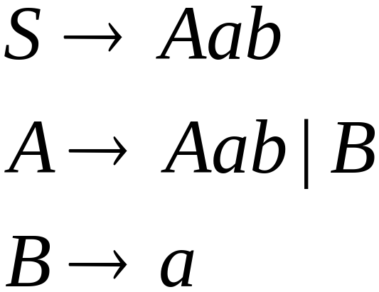
Left-Linear Grammars
All productions have form:
Example:
or
string of
terminals
Courtesy Costas Busch - RPI

Slide 34
Regular Grammars
Courtesy Costas Busch - RPI

Slide 35
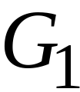
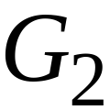
Regular Grammars
A regular grammar is any
right-linear or left-linear grammar
Examples:
Courtesy Costas Busch - RPI

Slide 36
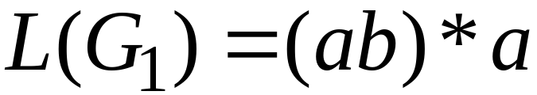
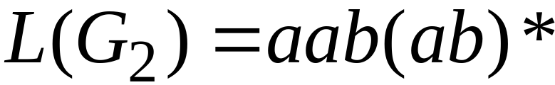
Observation
Regular grammars generate regular languages
Examples:
Courtesy Costas Busch - RPI

Slide 37
Regular Grammars
Generate
Regular Languages
Courtesy Costas Busch - RPI

Slide 38

Theorem
Languages
Generated by
Regular Grammars
Regular
Languages
Courtesy Costas Busch - RPI

Slide 39

Theorem - Part 1
Languages
Generated by
Regular Grammars
Regular
Languages
Any regular grammar generates
a regular language
Courtesy Costas Busch - RPI

Slide 40

Theorem - Part 2
Languages
Generated by
Regular Grammars
Regular
Languages
Any regular language is generated
by a regular grammar
Courtesy Costas Busch - RPI

Slide 41
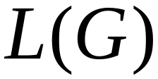
Proof – Part 1
Languages
Generated by
Regular Grammars
Regular
Languages
The language generated by
any regular grammar is regular
Courtesy Costas Busch - RPI

Slide 42

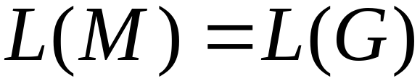
The case of Right-Linear Grammars
Let be a right-linear grammar
We will prove: is regular
Proof idea: We will construct NFA
with
Courtesy Costas Busch - RPI

Slide 43
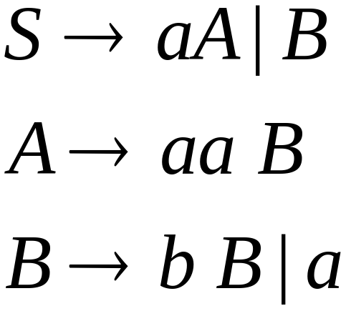
Grammar is right-linear
Example:
Courtesy Costas Busch - RPI

Slide 44



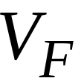

Construct NFA such that
every state is a grammar variable:
special
final state
Courtesy Costas Busch - RPI

Slide 45


Add edges for each production:
Courtesy Costas Busch - RPI

Slide 46

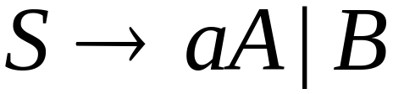
Courtesy Costas Busch - RPI

Slide 47
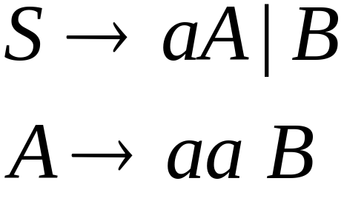
Courtesy Costas Busch - RPI

Slide 48
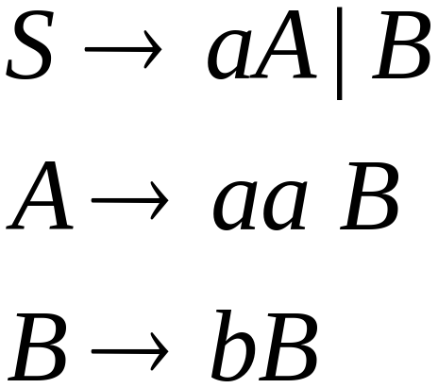

Courtesy Costas Busch - RPI

Slide 49
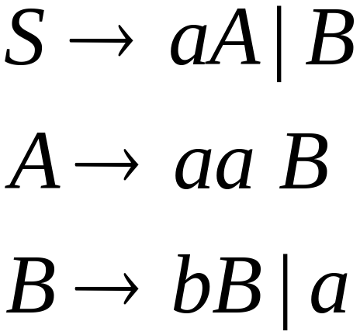
Courtesy Costas Busch - RPI

Slide 50
Courtesy Costas Busch - RPI

Slide 51
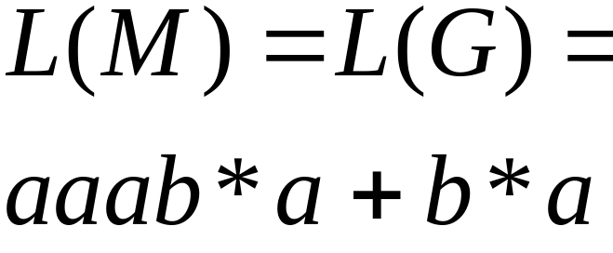
NFA
Grammar
Courtesy Costas Busch - RPI

Slide 52
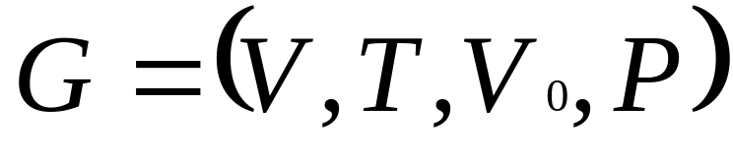
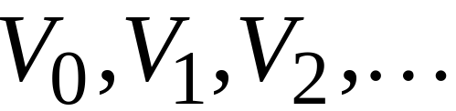
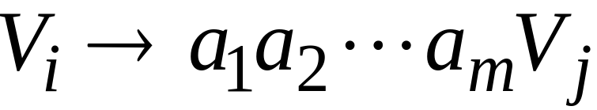
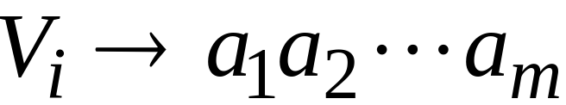
In General
A right-linear grammar
has variables:
and productions:
or
Courtesy Costas Busch - RPI

Slide 53







We construct the NFA such that:
each variable corresponds to a state, and is final state
Courtesy Costas Busch - RPI

Slide 54


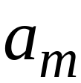


For each production:
we add transitions and intermediate nodes
………
Courtesy Costas Busch - RPI

Slide 55
For each production:
we add transitions to final node
………
Courtesy Costas Busch - RPI

Slide 56







Resulting NFA looks like this:
It holds that:
Courtesy Costas Busch - RPI

Slide 57
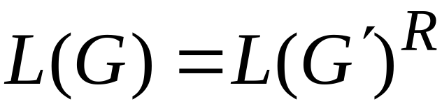

The case of Left-Linear Grammars
Let be a left-linear grammar
We will prove: is regular
Proof idea:
We will construct a right-linear
grammar with
Courtesy Costas Busch - RPI

Slide 58
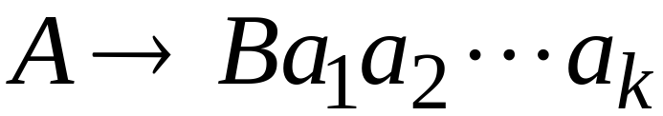
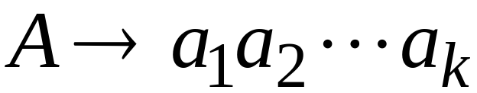
Since is left-linear grammar
the productions look like:
Courtesy Costas Busch - RPI

Slide 59

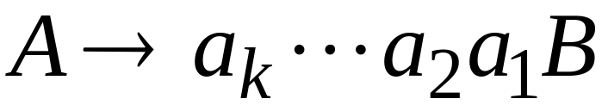
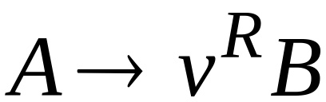
Construct right-linear grammar
Left
linear
Right
linear
Courtesy Costas Busch - RPI

Slide 60

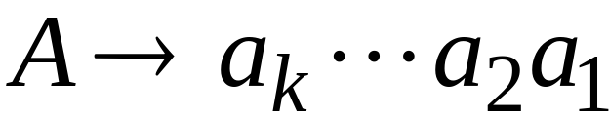

Construct right-linear grammar
Left
linear
Right
linear
Courtesy Costas Busch - RPI

Slide 61


It is easy to see that:
Since is right-linear, we have:
Regular
Language
Regular
Language
Regular
Language
Courtesy Costas Busch - RPI

Slide 62

Proof - Part 2
Languages
Generated by
Regular Grammars
Regular
Languages
Any regular language is generated
by some regular grammar
Courtesy Costas Busch - RPI

Slide 63

Any regular language is generated
by some regular grammar
Proof idea:
Let be the NFA with .
Construct from a regular grammar
such that
Courtesy Costas Busch - RPI

Slide 64





Since is regular
there is an NFA such that
Example:
Courtesy Costas Busch - RPI

Slide 65




Convert to a right-linear grammar
Courtesy Costas Busch - RPI

Slide 66

Courtesy Costas Busch - RPI

Slide 67

Courtesy Costas Busch - RPI

Slide 68


Courtesy Costas Busch - RPI

Slide 69



In General
For any transition:
Add production:
variable
terminal
variable
Courtesy Costas Busch - RPI

Slide 70


For any final state:
Add production:
Courtesy Costas Busch - RPI

Slide 71
Since is right-linear grammar
is also a regular grammar
with
Courtesy Costas Busch - RPI

